Slide 1
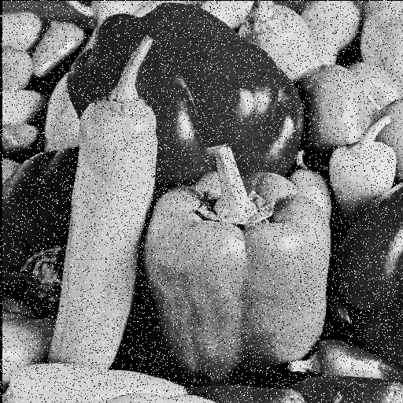
Homework: Median Filtering
Enhance the attached image using Median filtering.
Compare the effects of various filter sizes such as 3x3, 5x5, and 7x7.

